Slide 1








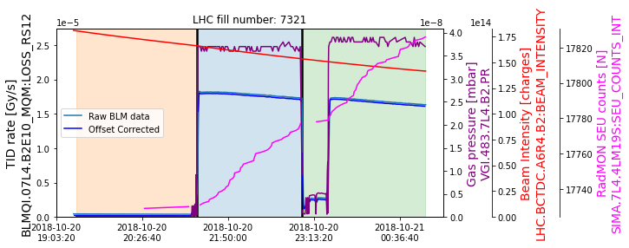
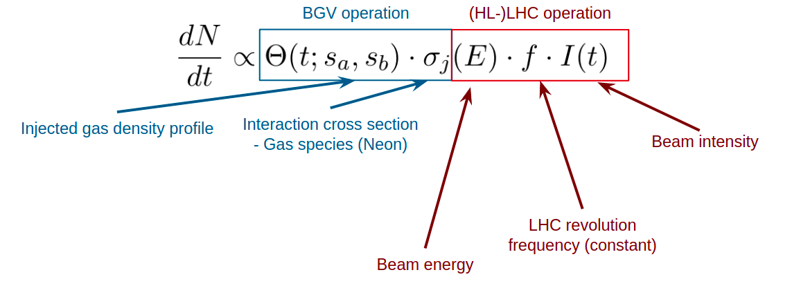
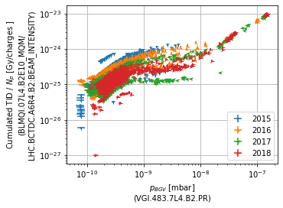
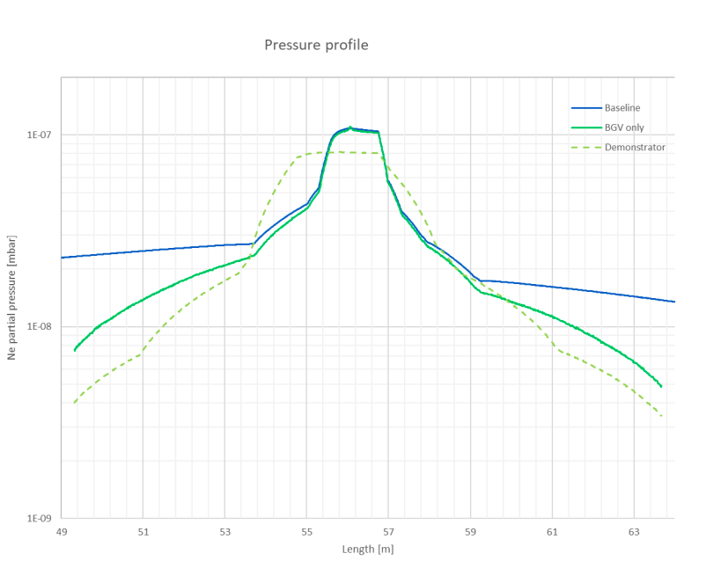
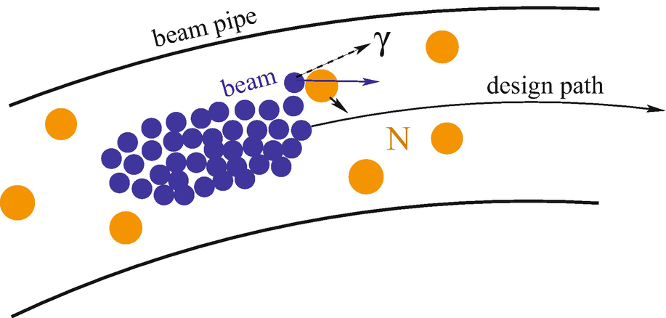
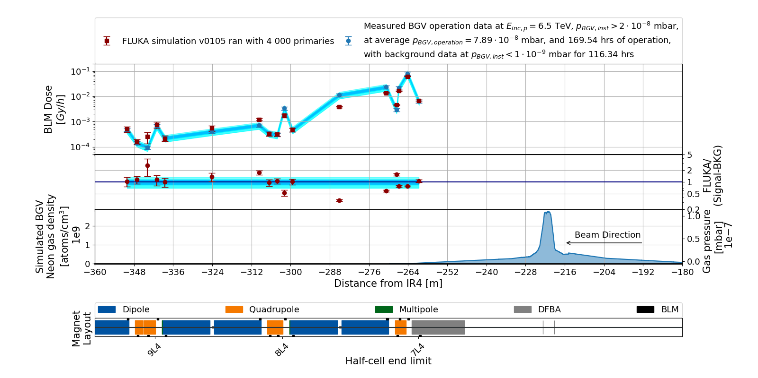
BGV beam-gas collisions at IR4 and related radiation levels
Daniel Prelipcean^{1,2} (daniel.prelipcean@cern.ch)
With input from Giuseppe Lerner¹, Bernadette Kolbinger¹, Helene Guerin¹, James Storey¹, Alessio Galloro¹, Roberto Kersevan¹
¹CERN (CH-1211 Geneva), ²Technical University of Munich (DE-80333 München)
1. The Large Hadron Collider (LHC)
3. Measured BLM data from the LHC Run 2
The radiation levels caused by the Beam Gas Vertex (BGV) [1] operation in IR4 of the Large Hadron Collider (LHC) [2] at CERN are discussed. The key ingredients of the analysis are:
Measurements of Total Ionising Dose (TID) performed with the Beam Loss Monitoring (BLM) system [3] from LHC Run 2, during the operation of the BGV demonstrator.
FLUKA [4-6] simulations of beam gas interactions for the past LHC Run 2 (benchmark) and future HL-LHC scenarios (radiation levels prediction).
Main goal is to determine whether the operation of these devices can lead to R2E issues or excessive heat loads on cryogenics systems.
During a fill, when gas is injected in the BGV, one expects the BLM TID rate signal to be proportional to the product of pressure and intensity.
For the analysis, we have identified time periods (up to ~1h), with rather constant gas pressure, and higher than a predefined threshold of 2×10-8 mbar, within different beam modes (PRERAMP, FLATTOP & STABLEBEAMS)
2. Radiation source and normalization
Any residual gas will lead to beam-gas interactions causing local radiation showers. This effect can be used to measure the beam profile/position, if there are sufficient secondaries produced. The Beam Gas elements in IR4 inject gas (typically Ne) to increase the local density and measure the secondaries for beam profile reconstruction. The radiation levels scale as:
Fig. 2: BLM BLMQI.07L4.B2E10_MQM measured TID (blue) for a time period within LHC fill number 7321, showing the beam intensity (red) as measured by the BCT instruments for beam 2 and the BGV pressure gauge reading (purple), together with the RadMON SIMA.7L4.4LM19S cummulated SEU counts (magenta).
Fig. 3: BLM BLMQI.07L4.B2E10_MQM measured TID divided by the beam intensity of charges plotted against the BGV pressure gauge reading for all the time periods under consideration, for each year of Run 2 operation.
4. FLUKA vs Measured data in the LHC tunnel
The geometry of the LHC tunnel and the relevant beam line elements have been reproduced in FLUKA and the radiation source consisted in just the inelastic beam-gas interactions. The shape of the BLM profile is well reproduced in Figure 3, exhibit a satisfactory global agreement, with local outliers that require further investigation.
Fig. 1: (Left) Gas profile used for the BGV demonstrator (dashed) and adjusted profiles for the BGV for HL-LHC, considering the vacuum sector (blue) and without (green). (Right) Diagram for beam-gas interactions.
5. Conclusions
This study aimed to test the understanding of the loss pattern and the mechanism generating the losses, as well as to validate the use of simulation tools like FLUKA and their predicting power in the difficult scenario of the LHC accelerator, which consists of a complex radiation field and for a radiation source propagating into a geometry that spans hundreds of meters [7, 8].
When used, BGV becomes locally the main source of radiation. We build confidence from the Run 2 LHC benchmark with measured data in order to predict the expected HL-LHC radiation levels.
Fig. 2: Top pannel: Comparison between BLM data and FLUKA predictions for. Center pannel: The ratio of FLUKA simulated values to the BLM measurements. Lower pannel: Gas profile. Bottom: Accelerator elements layout.
References
The BGV Collaboration , Noninvasive LHC transverse beam size measurement using inelastic beam-gas interactions. Physical Review Accelerator Beams, vol. 22, issue 4, April 2019. https://link.aps.org/doi/10.1103/PhysRevAccelBeams.22.042801
O. Brüning et al. LHC Design Report. CERN Yellow Reports: Monographs. CERN, Geneva, 2004. doi:10.5170/CERN-2004-003-V-1. URL https://cds.cern.ch/record/782076.
E. B. Holzer et al. Beam loss monitoring system for the LHC. IEEE Nuclear Science Symposium, 2:1052 –1056, November 2005. doi: 10.1109/NSSMIC.2005.1596433.
FLUKA website. URL https://fluka.cern.
C. Ahdida et al. New Capabilities of the FLUKA Multi-Purpose Code. Frontiers in Physics, 9, 2022. ISSN
2296-424X. URL https://www.frontiersin.org/article/10.3389/fphy.2021.788253.
G. Battistoni et al. Overview of the FLUKA code. Annals Nucl. Energy, 82:10–18, 2015. doi: 10.1016/j.anucene.2014.11.007
Daniel Prelipcean, Master Thesis: Comparison between measured radiation levels and FLUKA simulations at CHARM and in the LHC tunnel of P1-5 within the R2E project in Run 2. Presented July 2022. https://cds.cern.ch/record/2777059
A. Lechner et al. Validation of energy deposition simulations for proton and heavy ion losses in the CERN
Large Hadron Collider. Phys. Rev. Accel. Beams, 22:071003, Jul 2019. URL https://link.aps.org/doi/10.1103/PhysRevAccelBeams.22.071003

